Slide 1
CHANGE IN PRINCIPAL SCREEN

Slide 2
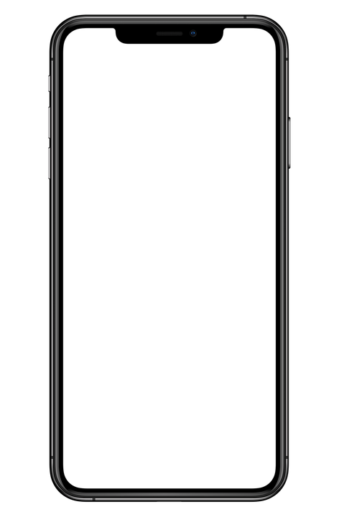
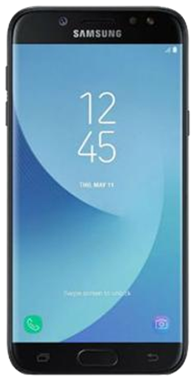



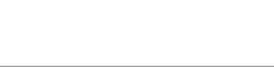
THE RED BOXED SCREENS IS THE NEW TO PROGRAM
2
1
NEW MAIN SCREEN WITH OPTION TO REGISTER
(THE PREVIOUS HAD NO REGISTER OPTION)
IF YOU TOUC THE BOX TO ADD PASSWORD AND USER
screen flashing at startup and charging
TO LOGIN

Slide 3
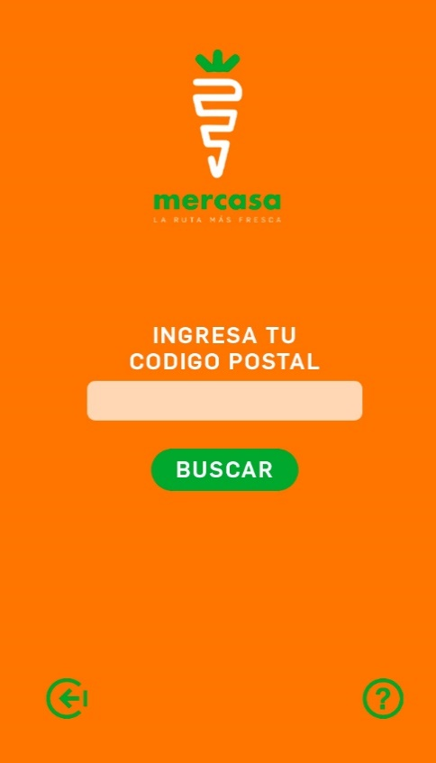
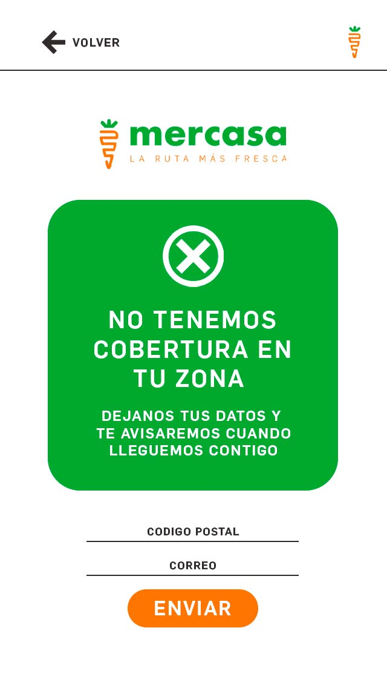
NO TENEMOS COBERTURA PERO MUY PRONTO ESTAREMOS EN TU COLONIA DEJANOS TU CORREO Y CODIGO POSTAL Y TE AVISAREMOS
IF YO PRESS “REGISTRATE” GO TO THIS SCREEN
CORREO
CODIGO POSTAL
REGISTRATE
ENVIAR
PANTALLA 2 NO COBERTURA
PANTALLA 1
PANTALLA 3
THIS SCREEN CHECK COVERAGE BY COMPARING A ZIP CODE WITH A DATABASE THAT MUST BE PROGRAMMED
IF YOUR ZIP CODE IS NOT IN OUR BASE, THE OPTION WILL BE GIVEN TO LEAVE YOUR MAIL TO LATER NOTIFY YOU

Slide 4
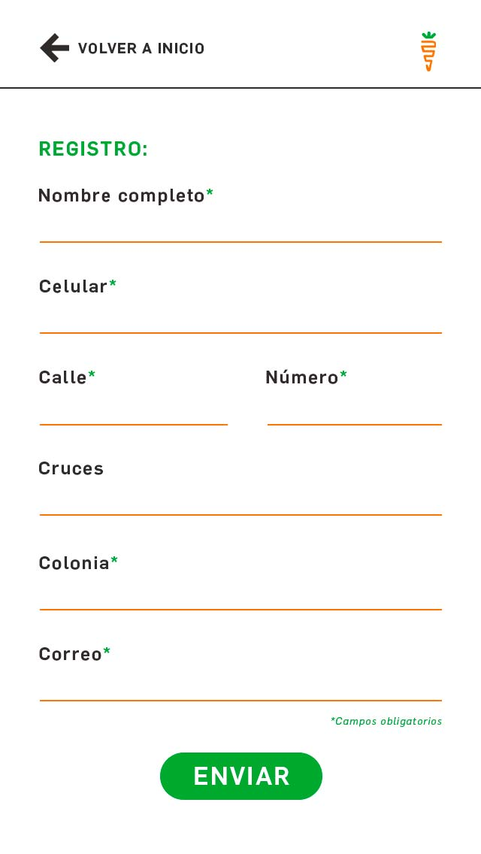
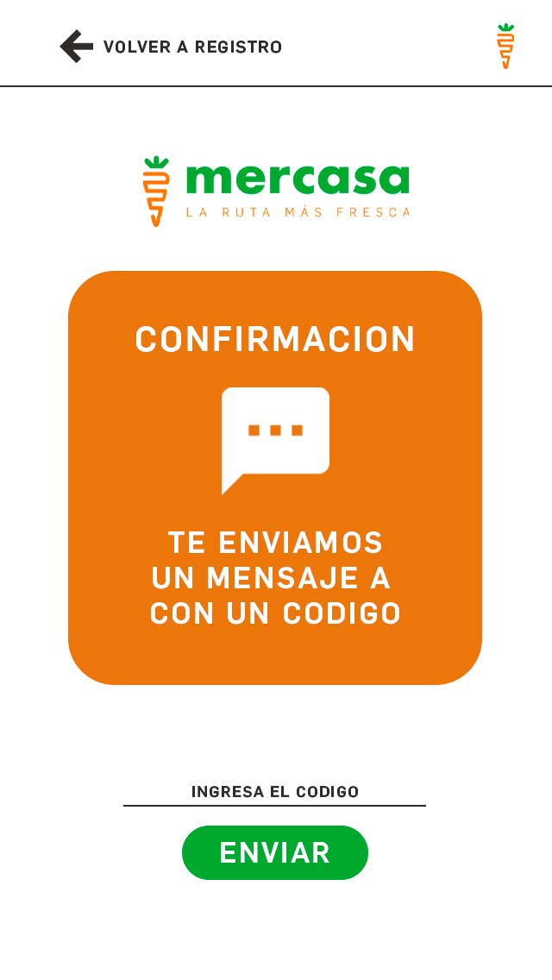
PANTALLA REGISTRATE
REGISTRARME
ENVIAR
PANTALLA 3
IF YOUR ZIP CODE IS IN OUR BASE IT WILL GO TO THIS SCREEN FOR REGISTRATION
"CELL PHONE VERIFICATION", IF IT IS CORRECT, IT WILL GO TO THE MAIN SCREEN, IF IT WILL NOT BE SENT AGAIN

Slide 5
MAIN SCREEN AND CATEGORIES

Slide 6
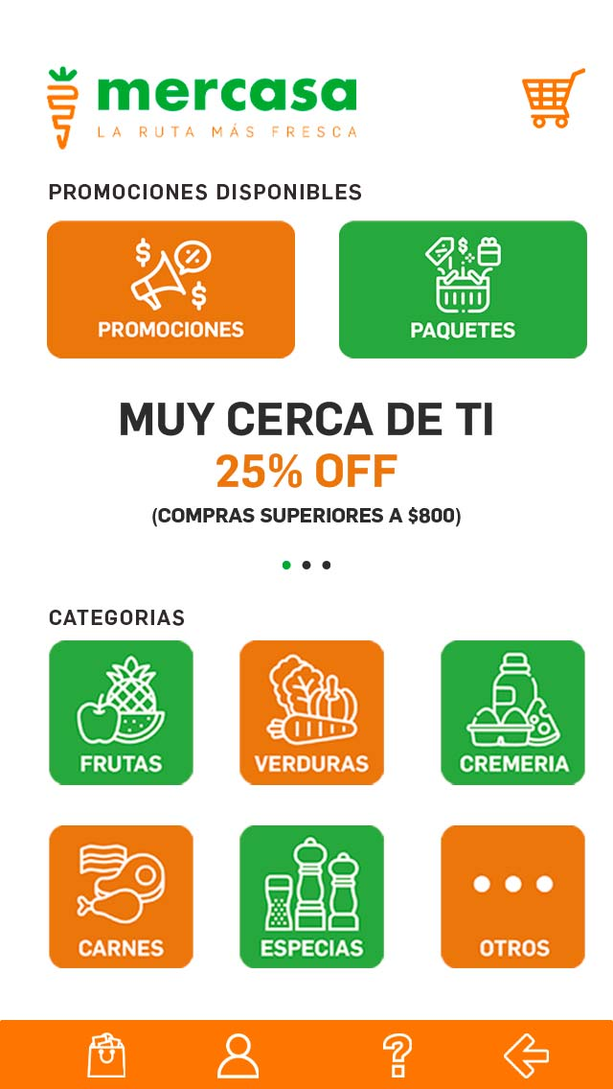
THIS IS THE NEW MAIN SCREEN
THE CURRENT SCREEN ONLY HAS CATEGORIES I AM INTERESTED IN ADDING SOME ELEMENTS TO THIS SCREEN. THEREFORE IT WILL BE A NEW MAIN SCREEN.
CART SHOPPING
CART SHOPPING
A SECTION OF CUSTOMIZABLE PACKAGE FOR EACH CUSTOMER
A SECTION OF CUSTOMIZABLE PROMOTION FOR EACH CUSTOMER
THIS SECTION MUST BE POSSIBLE TO MODIFY (FOR EACH CUSTOMER I HAVE DIFFERENT PROMOTIONS). IT'S JUST TO SEE WHAT IS IN PROMOTION.
CATEGORIES . I NEDD TO ADD 2 CATEGORIES, (BEFORE I ONLY HAVE 4)
EXIT TO FIRST SCREEN
GO TO MODIFY ADDRESS AND OTHER DATA
TO SEE PREVIOUS ORDERS
GO TO WHATSAPP FOR HELP

Slide 7
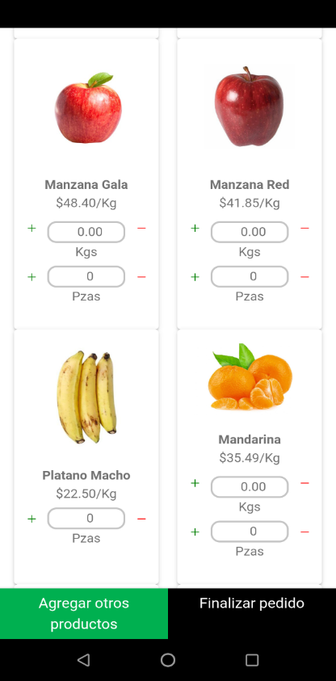
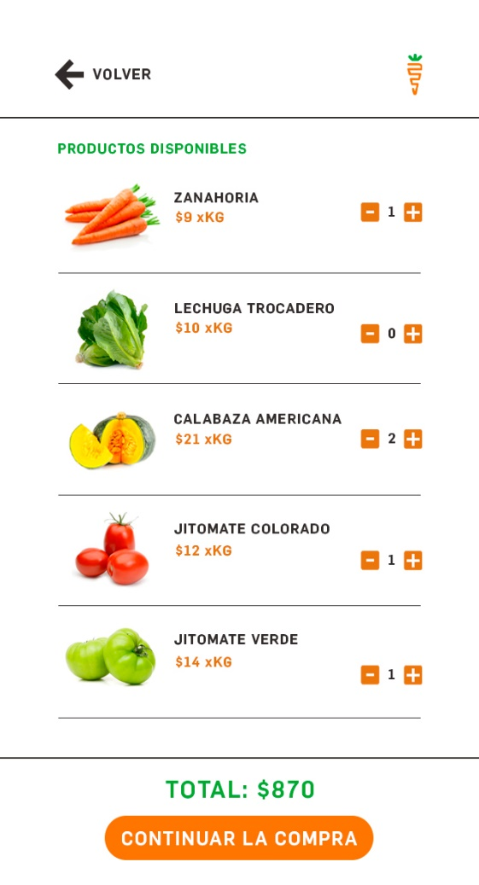
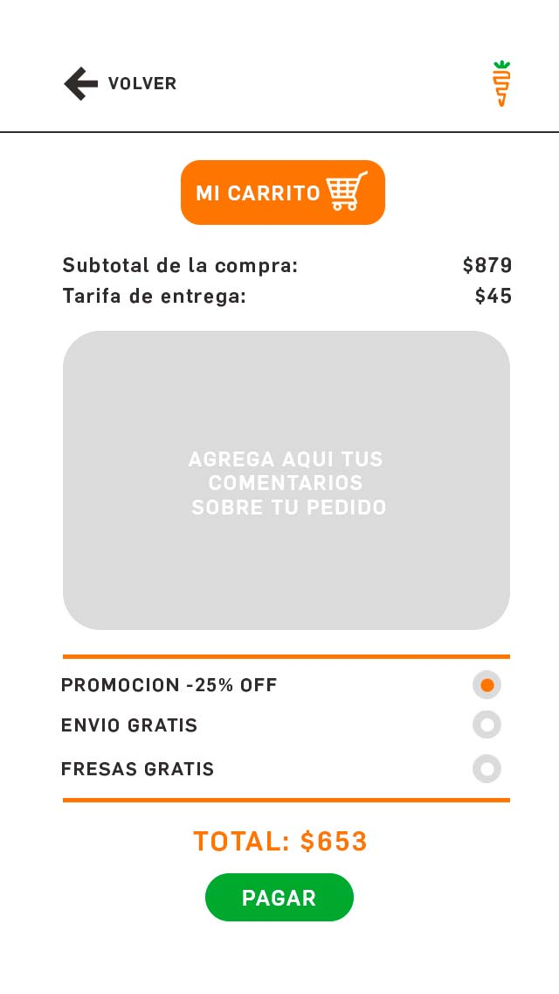
HERE IT WILL SHOW THE BREAKDOWN OF THE TOTAL:
SHIPPING
-TOTAL OF PRODUCTS
- DISCOUNT IF ANY APPLIED PROMOTION
THE CLIENT HAVE THE OPTION TO PUT COMMENTS ABOUT HIS ORDERS
PROGRAM THIS ONE, TO SHOW THE AVAILABLE PROMOTION… AND WHEN THEY SELECT ONE APPLY THE CORRESPONDING DISCOUNT
PANTALLA VER CARRITO
This screen already exists WE WILL CHANGE DESIGN SHOWS THE CART

Slide 8
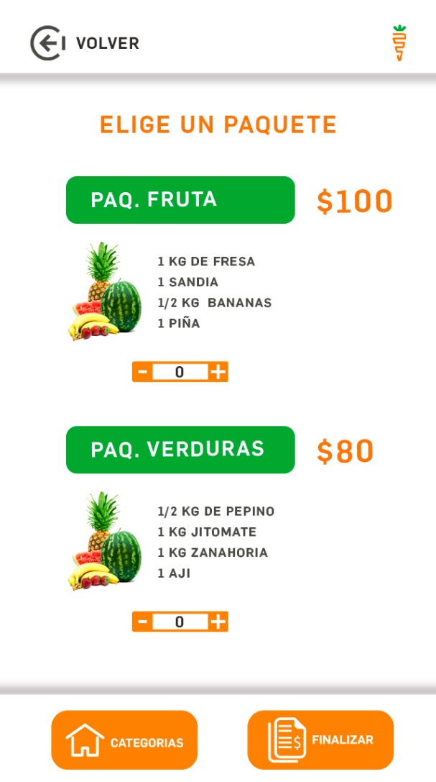
NEW SECTION TO SEE DIFFERENT AVAILABLE PACKAGES PER CUSTOMER
HAVE THE POSSIBILITY OF CREATING PACKAGES WITH PRODUCTS OF THE APP TO ASSIGN A TOTAL TO THEM AND THAT THE CLIENT CAN CHOOSE THEM
VER PAQUETES

Slide 9
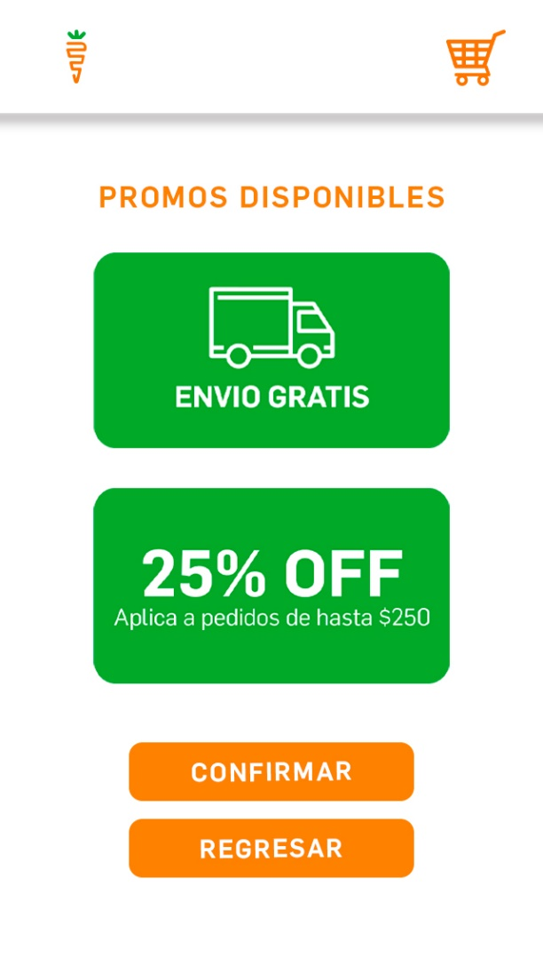
“PROMOCIONES”
THIS SCREEN ONLY SHOWS THE AVALIBLE PROMOTIONS PER CUSTOMER (IMAGES)
CUSTOMIZABLE BY CUSTOMER

Slide 10
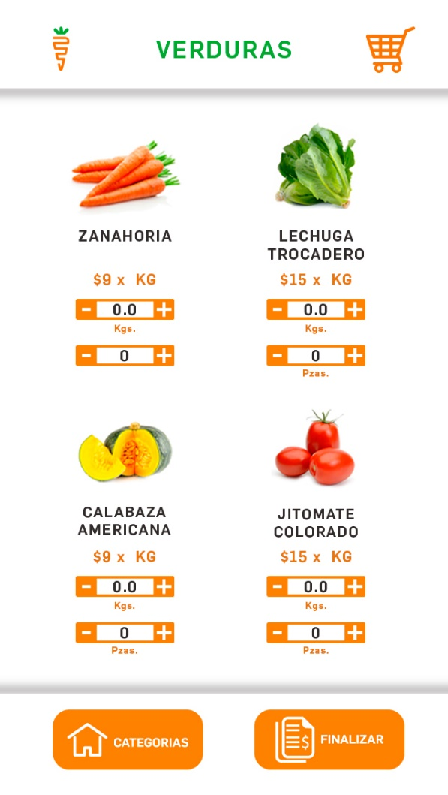
THIS SCREEN ALREADY EXIST AND PROGRAM, WE WILL CHANGE THE DESIGN
6 CATEGORIES INSTEAD OF THE CURRENT 3
SCREEN NAME: “PANTALLA COMPRA VERDURAS”
GO TO CART
VERDURA
ESPECIAS
CARNES
FRUTA
CREMERIA
BOTONS TO GO BACK AND GO TO PAY
OTROS

Slide 11
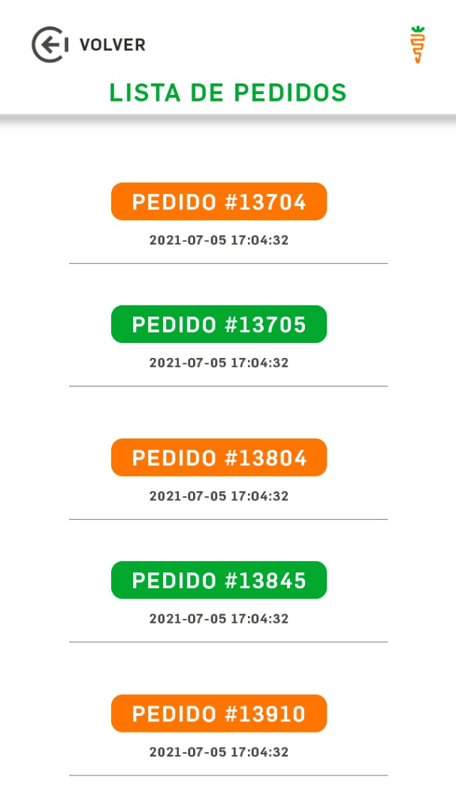
THIS SCREEN IS ALREADY PROGRAMMED BUT IT HAD ANOTHER DESIGN, YOU HAVE TO PLACE THIS DESIGN
SCREEN NAME: “PANTALLA LISTADO DE PRODUCTOS”

Slide 12
SCREENS TO FINISH YOUR PURCHASE

Slide 13
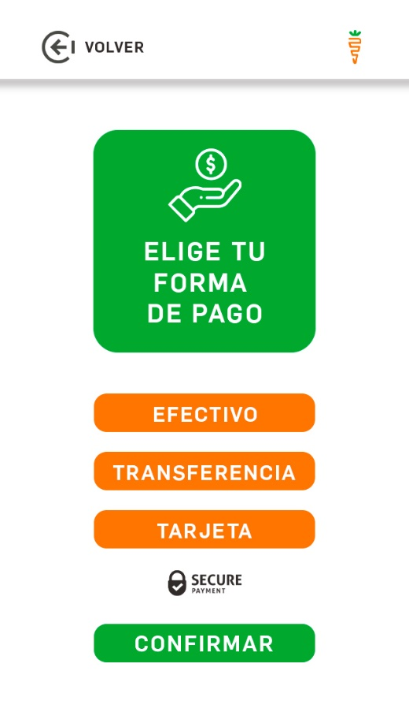
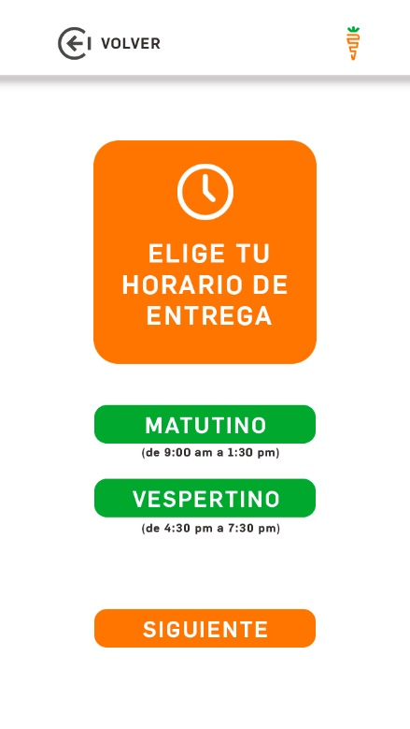
ELIGE TU HORARIO DE ENTREGA
MATUTINO
VESPERTINO
SIGUIENTE
PANTALLA “HORARIO DE ENTREGA”
PANTALLA “FORMA DE PAGO”
NEW SCREEN TO SELECT DELIVERY SCHEDULE
NEW SECTION ON EXISTING SCREEN
HERE WILL APPEAR THE PROMOTIONS AVAILABLE TO THAT CUSTOMER TO CHOOSE

Slide 14
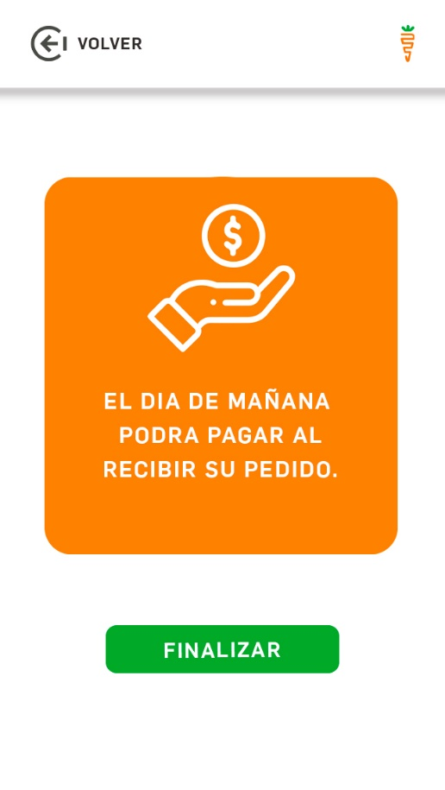
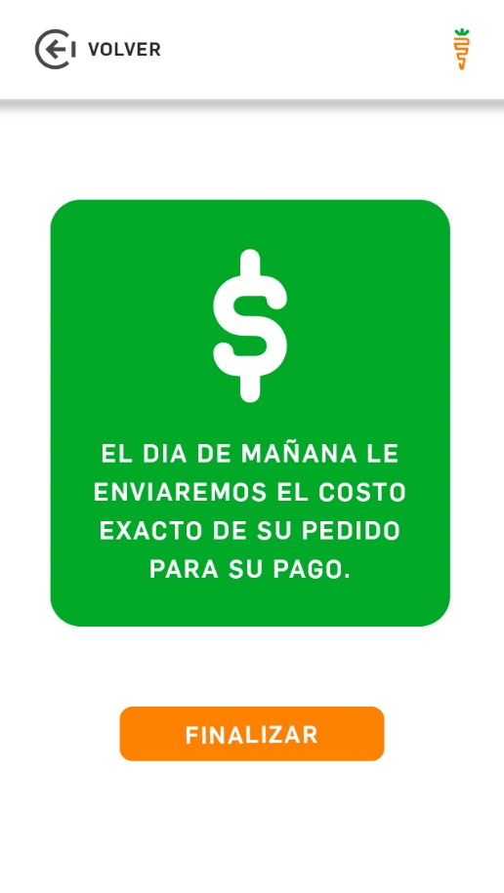
PANTALLA “PAGO EN EFECTIVO”
PANTALLA “PAGO EN EFECTIVO”
GO TO MAIN SCREEN
GO TO MAIN SCREEN

Slide 15
PAYMENT GATEWAY

Slide 16
PAY WHIT CREDIT CARD
EL TOTAL DE SU COMPRA ES:
PROGRAM TO SEND A PUSH NOTIFICATION WITH THE TOTAL TO THE CUSTOMER.
WE WILL HAVE THIS TOTAL THE FOLLOWING DAY WHEN WE WEIGHT THE PRODUCTS
ESTA ES LA PASARELA DE PAGO PAYPAL PARA INGRESAR DATOS DE TARJETA
GRACIAS POR SU COMPRA SU PAGO QUEDO REGISTRADO
$5
TRANSFERENCIA
PAGO TARJETA
PAGAR
FINALIZAR
PANTALLA METODO PAGO
PANTALLA GRACIAS
PANTALLA COBRO TARJETA
WHEN THE CLIENT PRESS PAY THIS SCREEN WILL BE SHOW TO PAY BY PAYPAL
PAYMENT IS CONFIRMED AND BY PRESSING “FINALIZAR” WE RETURN TO THE MAIN SCREEN

Slide 17
PAY WHIT TRANSFERS
PROGRAM TO SEND A PUSH NOTIFICATION WITH THE TOTAL TO THE CUSTOMER.
WE WILL HAVE THIS TOTAL THE FOLLOWING DAY WHEN WE WEIGHT THE PRODUCTS
POR FAVOR REALICE SU PAGO EN SU BANCO Y ENVIE UNA CAPTURA A NUESTRO WHATSAPP
EL TOTAL DE SU COMPRA ES:
$5
OPEN OUR WHATSAPP
TRANSFERENCIA
FINALIZAR
PAGO TARJETA
PANTALLA PAGO TARJETA
WHEN THE CLIENT PRESS PAY THIS SCREEN WILL BE SHOW TO PAY BY PAYPAL
IF YOU CHOOSE TO PAY BY TRANSFER THE TOTAL OF YOUR PAYMENT WILL BE SENT TO YOU UNTIL THE FOLLOWING DAY IN A PUSH NOTIFICATION

Slide 18
ME GUSTARIA QUE LA APP CUENTE CON LO SIGUIENTE
ABILITY TO SEND TOTALS TO CUSTOMERS FOR THEIR PAYMENT IN PUSH NOTIFICATION
- PUSH NOTIFICATIONS TO SEND PROMOTIONS TO CUSTOMERS
BE ABLE TO MANUALLY MODIFY CUSTOMER RECORDS AND DELETE OR DEACTIVATE CUSTOMERS (IN THE ADMINISTRATOR APP)
NECESSARY DATA BASES TO MODIFY PROMOTIONS, COVERAGES AND PACKAGES
AND IN GENERAL THE PROGRAMMING NECESSARY TO APPLY THE FUNCTIONALITIES MENTIONED IN THIS FILE OF THE APP

